Slide 1


ITC 6000 Database Management Systems Final Project Presentation 2023 Winter B Online store for College Convenience
Ankit Bhalekar, Apurwa Sontakke, Lazaree Worlikar, Vedant Wagh

Slide 2
Overview
Project Overview
User Persona’s
Business Rules
ER Diagram
Solution Architecture and HA
Major SQL examples
Metrics
Security & Privacy Concerns
Next steps / Lessons learned

Slide 3

Project Overview
Online store for College Convenience store.
College Convenience is an e-commerce site for college convenience that allows students to order local food ingredients from the comfort of their own homes.
It will benefit both the customer as well as the seller as he will be able to expand his business and reach more people.
Our idea intends to make life easier for Northeastern University students by giving them access to an online platform where they can easily order their local products

Slide 4
Personas
Current college students
- Potentially thousands of students
- As a current graduate student, I want to:
- Use college convenience website to save time and order ready to cook items.
Working Professionals
- Potentially thousands of working professionals
- As a working professional, I want to:
- Order spices to cook meals which I used back home.

Slide 5
Persona
Restaurant owner
- Potentially hundreds of international cuisine restaurants
- As a restaurant owner, I want to:
- Order all the international ingredients needed to prepare dishes.
Shopkeeper
Currently one , may increase as number of physical shops increase
As a shop owner, I want to :
- Understand my customers.
- Identify High rated products.
- Identify Low rated products.

Slide 6
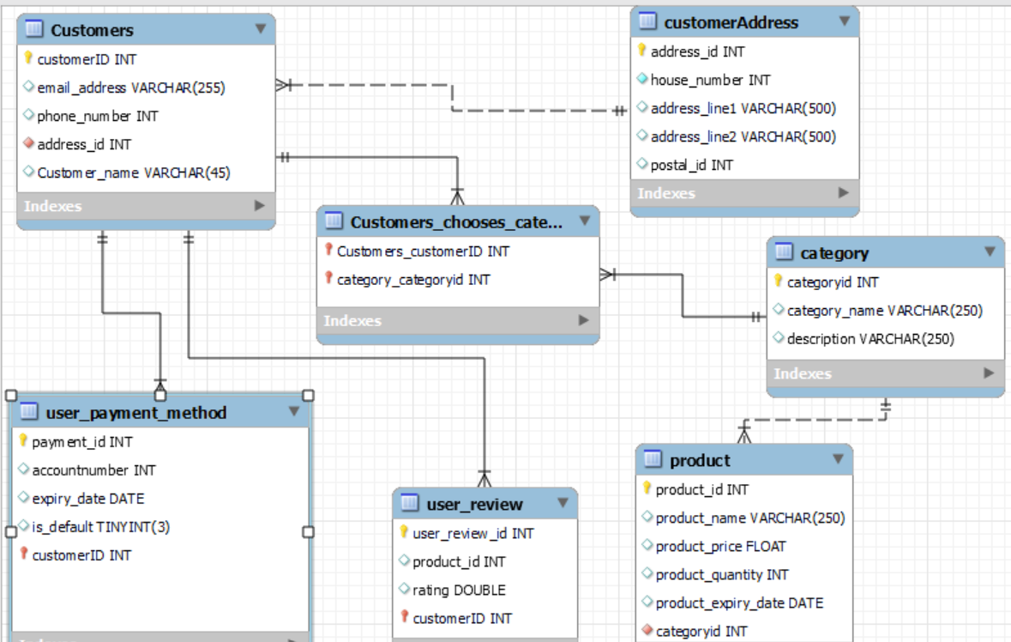
ER Diagram

Slide 7
Other Business Rules
Product Catalogue: The website should include a thorough product catalogue that includes name, characterizations, photos, costs and available stock. This should enable simple searching and filtering of products. All the products the owner uploads will be stored in product entity.
Order Management: The website should allow the administrator to manage orders, view order history and update order status.
Security: The website should have proper security measures to protect user data such as encryption and secure storage.
Ratings: The website should allow users to provide ratings for products and services. The ratings by user will be stored which will help the shopkeeper understand the areas of improvement.

Slide 8
Solution Architecture
Client/Server Architecture:
. This approach is advantageous for our project since it enables effective client-server communication, allowing for quicker replies and lessening the stress on the client side
Hosting Model:
It might be advantageous to host the College Convenience platform on the cloud. The database can be hosted using the scalable and economical cloud hosting service. We may simply raise or decrease storage capacity depending on demands by using a cloud-based hosting service.
Storage Requirements:
Our database's storage requirements will rely on the volume of data we intend to store and the volume of data the website will produce over time. We might require at least 10 GB of storage to start the database, to give you an approximate idea. Yet, if your website develops and produces more data, this number can rise.
In summary, for our project - Online website for College Convenience - a client/server architecture solution is appropriate, with the server being hosted in the cloud. We will likely need a minimum of 10 GB of storage, but this may increase as College Convenience’s website grows.

Slide 9
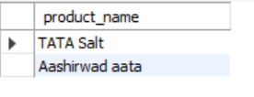
SQL Examples
Find out the highest rated products.
select product_name from product where productID in (select product_id from user_review where rating = (select max(rating) from user_review));
Explanation: The above code selects product name from the product table where the rating of the product is maximum in the user review table. The common column between the product and the user_review table is the product_id.
Output:

Slide 10
Give the name and address of the customers who have given rating less than the average rating
with average_rating_table as
(select customer_id from user_review where rating < (select avg(rating) from user_review))
select a.* ,b.*
from (select * from customeraddress where address_id in (select address_id from customers where customerID in (select * from average_rating_table))) a
left join customers b
on a.address_id = b.address_id;
Explanation : First a common table expression ( CTE) named average_rating_table is created which stores customer_id from user review table where the rating is less than the average rating.
Then from customeraddress table select address_id of those customers which were present in the CTE we created. Then left join that table with customers table to join all the customer details like their email ID, phone number etc.

Slide 11
Give the category and description and price of product and product name which is rated more than average
with more_than_avg as (select product_id from user_review where rating > (select avg(rating) from user_review))
select a.productid,a.product_name,a.product_price,b.category_name,b.description
from product a
left join category b
on a.category_id = b.categoryid
where a.productid in (select * from more_than_avg);
Explanation : First a common table expression ( CTE) named more_than_avg is created which stores product_id from user review table where the rating is more than the average rating.
Then left join category on product table with a where clause that product_id from the product table should be present in the CTE we created.

Slide 12
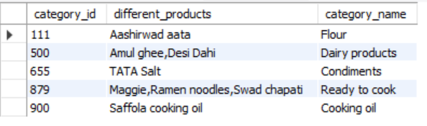
Show different products in each category
select a.*,b.category_name
from
(select category_id, group_concat(product_name) as different_products
from product
group by category_id) a
left join category b
on a.category_id = b.categoryid;
Explanation: To do this we will be joining the product and the category table. To view all the products on the same row against its respective category we will be using the group_concat function.
Output:

Slide 13
Metrics and Analytics
The shopkeeper can calculate the following metrics:
Number of items sold per day
Total profit per day
Total returns
Products with highest demands
Repeat Customers
Average order price

Slide 14
Security and Privacy
Data security: To avoid unauthorized access, sensitive customer data would be kept securely and access controls would be put in place.
Privacy policy: E-commerce website will have a privacy policy that is transparent and easy to understand and that explains how they gather, use, and safeguard consumer data.
HTTPS and SSL Certificates: HTTPS protocols will be used to keep the users’ sensitive data secure and boost the website’s rankings on Google search page.
Security Testing :To find vulnerabilities and to make sure security steps are working properly, regular security testing would be carried out.

Slide 15
Next steps / Lessons Learned
What were your key take-aways from this project?
Learnt to design database from scratch as well as complex SQL queries
What would you do differently next time?
Next time, we would try to implement the same database but with a front-end

Slide 16
Acknowledgement
We would like to express our sincere gratitude to Professor Anjum Biswas and the Teaching Assistant Leyla M for their invaluable guidance and support throughout this course.
Their dedication and expertise have been instrumental in helping us understand and apply the course material effectively.

Slide 17
Thankyou !

